Slide 1
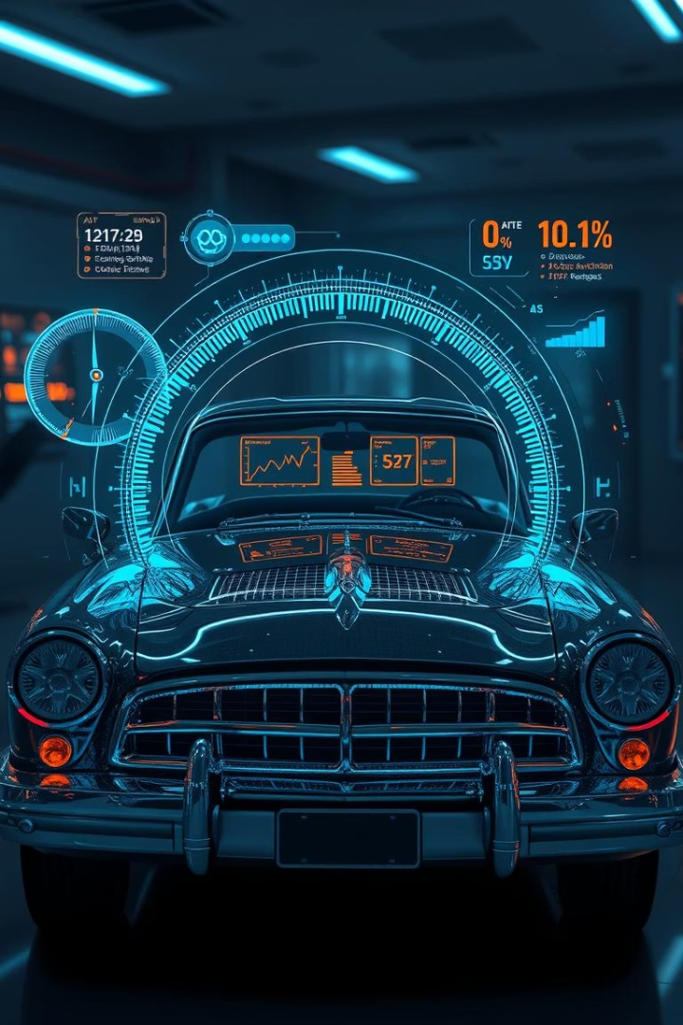

AI-Powered Old Car Price Prediction
Predicting old car prices with AI for precision and fairness.
by Vicky Kumar
Github link : - https://github.com/pseudovicky/project1

Slide 2

The Problem: Inaccurate Car Valuations
Traditional Methods
Expert opinions often outdated, causing unreliable valuations.
Market Inefficiency
Wide price gaps create challenges in fair negotiations.
Data Scarcity
Lack of comprehensive data for many old car models.
Financial Impact
Incorrect prices lead to losses for both buyers and sellers.

Slide 3
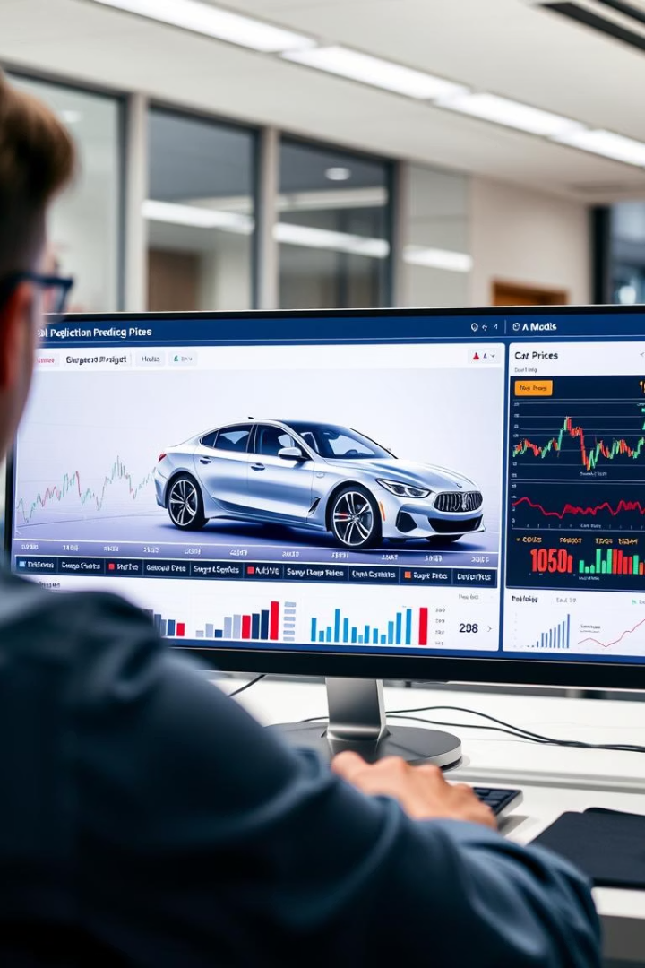
Our Solution: AI-Driven Price Prediction
Data-Driven Approach
Uses historical sales data for precise price estimates.
Machine Learning Models
Combines Linear Regression with AdaBoost to boost accuracy.
Real-time Updates
Adapts continuously as market conditions change.
Key Benefits
Ensures fair pricing and reduces negotiation time.

Slide 4
Technical Deep Dive: Algorithms and Data
Data Source
AdaBoost Algorithm
Collected via web scraping from Quikr.com
Improves model accuracy by combining weak learners
Linear Regression
Key Features
Establishes baseline predictions based on features
Year
Mileage
Condition
Make & Model

Slide 5

Web Scraping and Data Collection
Scraping Quikr.com
Extracted detailed car listings and specifications.
Data Cleaning
Addressed missing values and removed outliers for quality.
Feature Engineering
Created new attributes to boost model performance.
Data Volume
Collected a large, diverse dataset for robust training.

Slide 6
Full-Stack Implementation: Flask & Django
Backend
User Experience
Flask and Django serve AI model and APIs efficiently.
Input car details and receive instant price predictions.
Frontend
Scalability
Interactive UI built with HTML, CSS, and JavaScript.
Designed to support many users and high traffic loads.

Slide 7
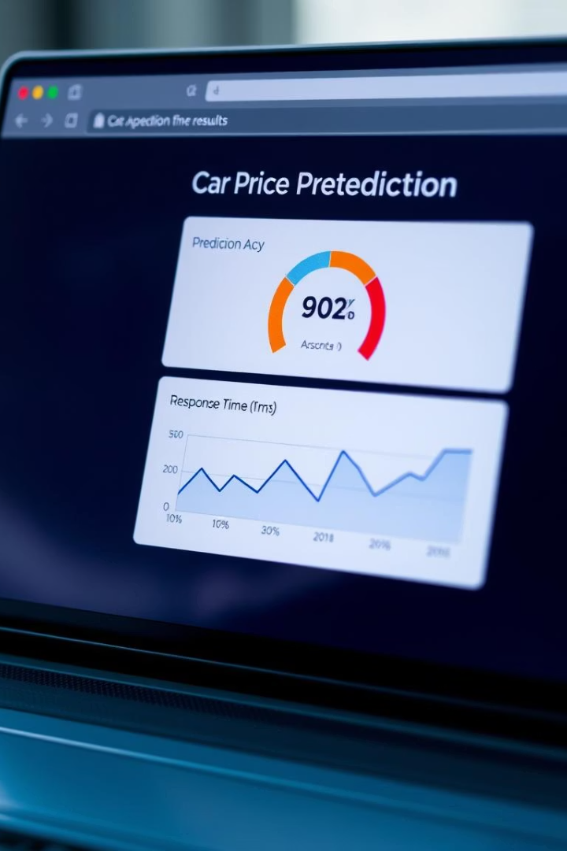
Demo and Results: Accuracy and Performance
Live Demo
Showcased user-friendly predictive web interface in action.
Accuracy Metrics
Achieved high R-squared and low Mean Absolute Error (MAE).
Performance
Fast response times, smooth user experience.
Improvement
Outperformed traditional methods by 15% in accuracy.

Slide 8
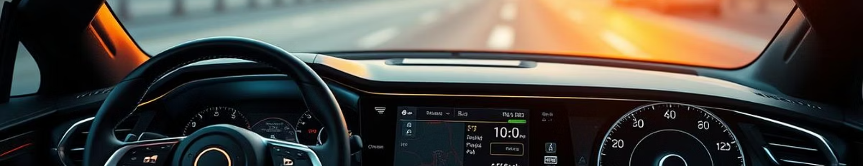
Conclusion and Future Enhancements
Next Steps
Future Work
Enhance UI, expand features, deploy on cloud.
Benefits
Add more data sources and advanced algorithms.
Summary
Improved market efficiency and decision making.
AI offers precise, fair old car price predictions.

